Slide 1


Bridging The Gap:
No Women Left Behind
©
American Association on Health and Disability

Slide 2
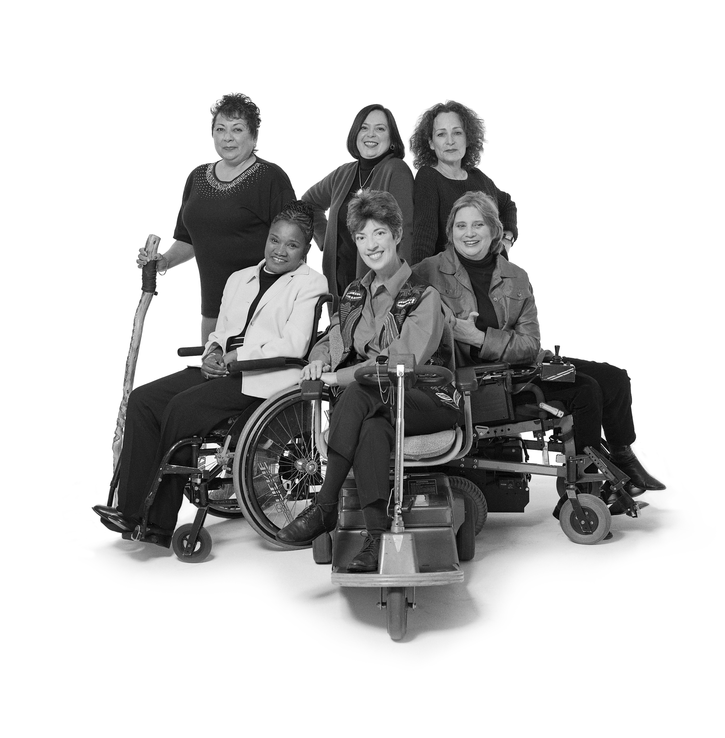
Overcoming Challenges: The Truth About Breast Cancer for Women With Disabilities
American Association on Health and Disability
©

Slide 3

Lightening Doesn’t Strike Twice, Right?
Women with disabilities are as likely to get breast cancer as the general population, and some women with disabilities have more factors for getting breast cancer than women in general.

Slide 4
Early Screening Can Save Your Life!
Women with disabilities, including African- American and Hispanic/Latina women, are more likely to be diagnosed with larger tumors and late stage breast cancer.
Women with disabilities are less likely to get regular clinical breast exams (when health care provider looks at and feels your breasts) and mammograms (x -rays of the breasts).
Notes:
4

Slide 5
Early Screening Can Save Your Life!
Knowing your breasts, having regular screenings by a health care provider and getting mammograms at regular intervals all help find breast cancer early.
Combined with improved treatments, early detection can save your life.
Five-year survival rate for early stage breast cancer is 93%!
Most women live full lives without cancer returning.

Slide 6
What’s Involved In Early Screening?
©
American Association on Health and Disability

Slide 7
Knowing Your Breasts
Familiarize yourself with how your breasts look and feel.
If you have trouble with knowing what is normal for you, get someone – a spouse or friend – to help, or ask your health care provider for assistance.

Slide 8
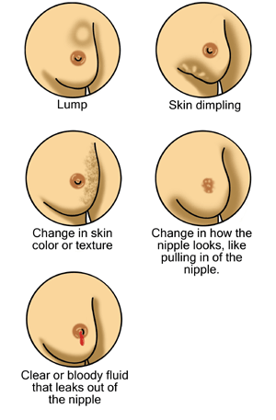
What To Look For
If you notice any of the following, make an appointment with your health care provider right away:
  Lump, hard knot or thickening
  Swelling
  Dimple or dent in skin
  Itchy sore on nipple
  Fluid coming from the nipple
  New pain that doesn’t go away
  Warmth, redness, or darkening

Slide 9
Knowing Your Risk
More than 90% of women who get breast cancer do not have a family history.
Being female is your biggest risk; age is second.
Having children after the age of 30.
Your own personal history of breast cancer.
Being obese or overweight.
Notes:
Examples of personal history include use of hormones, late onset of menopause, obesity, and smoking. People who smoked for 10 years or more were at least 16% more likely than nonsmokers to develop breast cancer, according to recent research. Make healthy lifestyle choices such as maintaining a healthy weight, exercising, limiting your alcohol intake, and limiting postmenopausal hormone use.

Slide 10
Susan G. Komen for the Cure ® Recommendations for Clinical Breast Exams
During clinical breast exams, health care provider looks at and feels breasts and underarms.
Start at age 20.
Ages 20 – 39 and no risk factors: at least every 3 years.
40 and older: every year.
Ask your health care provider how often to have a clinical breast exam if you are at a higher risk.

Slide 11
“Clinical breast exams are hard for me because I have difficulty raising and holding up my arms.”
Most health care providers can make arrangements to help women who have difficulty raising or holding up their arms get clinical breast exams if they know ahead of time.
When you make your appointment, say that you will need extra time for the exam and explain your needs.

Slide 12
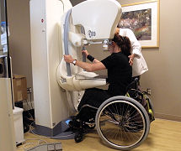
Susan G. Komen for the Cure ® Recommendations for Mammograms
Mammograms are x-rays of the breast.
Start at age 40.
Have a mammogram every year.
Ask your health care provider how often to have a mammogram if you are at a higher risk.

Slide 13
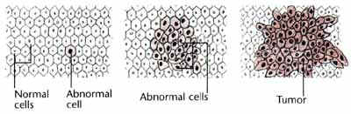
“I don’t need to get a mammogram on a regular basis because my clinical breast exams have always been negative.”
Mammograms (x-rays of the breasts) can identify cancerous cells before they become big enough to feel.
Susan G. Komen for the Cure recommends an annual mammogram for women forty and older.
Early screening saves lives!

Slide 14
“Getting a mammogram will hurt!”
Some women experience a few seconds of being uncomfortable when having a mammogram, but it almost never causes pain.
If you are menstruating, schedule your mammogram the week after your period, when your breasts should be less tender.
Bring someone with you for emotional support.

Slide 15

“A mammogram is too expensive; I could never afford it.”
The new Affordable Care Act has made mammograms affordable for nearly everyone.
    Insurance: mammograms and other preventive women’s services are covered at no cost.
    Medicare: preventive services, including mammograms, are free on an annual basis.
    Medicaid: all state plus D.C. Medicaid programs will cover screening mammograms.
    Additional Screening Option: National Breast and Cervical Cancer Early Detection Program (CDC) (1-800-232-4636) or www.cdc.gov/cancer
.

Slide 16
“There’s no point in getting a mammogram, if they find something it will be too late to do anything about it anyway.”
Times have changed! Survival is high because breast cancers respond well to treatment.
5 year survival rate for early stage breast cancer is 93%.
1 in 8 women over a lifetime are diagnosed with breast cancer.
There are 2 and 1/2 million breast cancer survivors in the U.S.
Many women treated with breast cancer go on to live long, productive lives, without recurrence.
Early screening saves lives!
Notes:
African American and Hispanic/Latina women compared to white women: lower incidence of breast cancer, but likely diagnosed at a later stage.

Slide 17

“I won’t be able to get a mammogram because the facility won’t be accessible.”
Susan G. Komen for the Cure sponsored an accessibility survey of mammography facilities in the DC area and most are accessible.
When you call to make an appointment, tell staff about issues that concern you.
Don’t be shy! This is your life!
Notes:
Show list of participating mammography facilities.

Slide 18
“Getting a mammogram will expose me to radiation and can actually give me breast cancer.”
Modern mammograms aren’t perfect, but they use very little radiation and can detect very small tumors that can’t be felt during a self-exam or even a clinical exam.
Benefits of mammograms far outweigh the costs.

Slide 19
“Changes in my mammogram or an unclear mammogram means I must have breast cancer.”
Not true! After your mammogram, the radiologist will read your x-ray. Further tests, such as an ultrasound, MRI or biopsy may be necessary to see if you have a cancerous tumor. These additional tests help the doctor determine if you have cancer and do not mean you have cancer.
It is important you get proper follow-up care after an abnormal mammogram. Getting called back for more tests is normal.

Slide 20
Screening Tips for Women with Disabilities
During the clinical breast exam, tell your health care provider what things make you uncomfortable and what makes an exam more comfortable for you.
©
American Association on Health and Disability

Slide 21
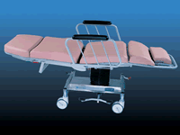
Clinical Breast Exams & Mammograms: Positioning
During the mammogram, find out what position is most comfortable for you and gets the best x-ray.
  Write it down so that you can remember it for the next time.
  Ask the technologist to include it in your records, since staff might change from year to year.
Early screening saves lives!
Notes:
Getting a clear X-ray makes a mammogram successful.

Slide 22
Clinical Breast Exams & Mammograms
Check out the list of accessible mammogram facilities in the DC area handed out at this presentation.
When you make an appointment for the first time, tell the staff member about your disability. Ask about access issues that are important to you. Be your own advocate and talk about your needs!
If you want to, ask a spouse, family member, friend, or caregiver to come with you.
Don’t be afraid to find another health care provider if your current one (or your first one) doesn’t take care of your needs.
Notes:
Tell scheduling staff about disability so health care provider can be prepared to help you during appointment.
Ask scheduling staff about getting to and within health care facility. Physical access areas that might concern you include the Parking lot or garage, Main building entrance, Elevator, Rest room, Exam table.
Have your spouse, family member, friend, or caregiver come with you for physical and/or emotional support.
Tell your health care provider what makes you uncomfortable and what makes an exam more comfortable for you.
22

Slide 23

“With my disability, no one will want to help me understand my diagnosis, treatment, follow-up, insurance, and accessibility challenges. I will be all alone.”
Most hospitals have Patient Navigators who help women diagnosed with breast cancer.
Patient Navigators provide information and support and often have had breast cancer.

Slide 24
“I hear treatment for breast cancer makes you really sick. I won’t be able to work or take care of my family. “
There are many types of treatment for breast cancer.
Often times side effects are minimal. There are medicines that help with many of the side effects of treatment.
If you have trouble coping, try eating healthy food, resting during the day if possible, getting physical activity, and seeking out emotional support.
Most women are able to work throughout breast cancer treatment.

Slide 25
“Once I finish treatment, I am cured, right?”
If you’ve had breast cancer, you may have a higher risk of developing a new breast cancer.
If you’ve had breast cancer, see your doctor regularly and continue screening.
Your doctor will tell you how often to see him/her, but it is usually 2-4 times per year.
In between appointments, report any changes in remaining breast or chest areas or any changes with how you feel.

Slide 26
Contact Information
For more information, please contact:
    The American Association on Health
    and Disability
      301-545-6140
      http://www.aahd.us
    Susan G. Komen for the Cure®
      1-877 GO KOMEN (1-877-465-6636)
      http://ww5.komen.org
©

