Slide 1
“Project Accessibility: Removing Barriers for Women with Disabilities”
Roberta Carlin, MS, JD
Janet Kreitman, MAPA, MSW

Slide 2
American Association on Health and Disability
Advance health promotion and wellness initiatives (federal, state and community)
Integrate disability into the public health agenda
Reduce health disparities and incidence of secondary conditions by identifying effective intervention strategies
Accomplish mission through advocacy, research, education and public awareness

Slide 3
Project Accessibility: Removing Barriers for Women with Disabilities
Overview
Program Components
Program Materials
Barriers
Project Evaluation
Next Steps

Slide 4
Mammography Facts
Almost 18% of female population (16-64) live with a sensory, physical or mental disability
Women with disabilities, especially those with significant limitations, receive mammograms less often and are diagnosed at a later stage
Disparity stems from a combination of environmental, attitudinal, and communication barriers

Slide 5
Project Accessibility Overview
Funded by Susan G. Komen For the Cure (2007, 2009-2010)
Implement a comprehensive education intervention targeting women with disabilities who face physical, cultural and communication barriers to increase breast cancer screening

Slide 6
Project Accessibility Overview
Increase facility accessibility (physical, communication, attitudinal, cultural) by identifying and removing barriers in mammogram facilities
Increase disability awareness, sensitivity and knowledge of healthcare providers at mammogram facilities

Slide 7
Project Accessibility: Major Program Components
On-site Facility Assessment Site N=60
Administered Accessibility Survey Instrument
Provided Follow-up Written Report
Developed Project Materials
DVD-BHAWD-Mammography Technologists (CEU’s)
Created Disability and Cultural Awareness Compendium for Mammography Facilities
Provided On-going Technical Assistance
Project Evaluation

Slide 8
Project Accessibility: Facility Survey
Facility Demographics
Customer Service (Scheduling, Alternative Formats, Disability Training)
Facility Access (Parking, Building, Waiting Area, Dressing Room, Mammography Suite, Bathrooms)

Slide 9
Project Accessibility: Program Materials
Intro Letter to Mammography Sites
Mammography Facility Accessibility Survey
Sample Press Releases
Fact Sheet on “Project Accessibility”
Tips Sheets/Brochures: Tips for Women with Disabilities: Getting Your Mammogram
Tip Sheets/Brochures: Tips for Mammography Staff: How to Effectively Serve Women with Disabilities

Slide 10
Project Accessibility: Program Materials
Into Letter: Breast Cancer Screening Survey
Breast Cancer Screening Survey
Intake Questionnaire for Scheduling
Cultural Competency Resources
DVD Format – Visual Impairments (Tip Sheets)
Multi-Cultural Komen Breast Self Awareness Cards
Spanish/Alternative Format
Post Survey Evaluation
ADA Disability Rights/Surgeon General Report
Right To Know Campaign Kit-CDC

Slide 11
Project Accessibility: Physical Barriers
Physical Barriers: (lack of working main entrance automatic door openers, lack of van accessible parking, dressing rooms with no horizontal handrails to support transfer, not adequate room for wheelchair turning in dressing rooms, doorways to narrow to enter changing room, unable to enter facility due to heavy doors, mammography machines with machine plates not lowering to an acceptable height, exam tables)

Slide 12
Project Accessibility: Cultural Barriers
Cultural Barriers (most surveyed facilities diverse population-only Spanish materials)
Use of interpreters- primarily relied on family members
Minimal TTY machines
Lack of alternative formats

Slide 13
Project Accessibility: Attitudinal Barriers
Attitudinal Barriers (lack of staff training serving women with disabilities, lack of training in positioning, no cultural competency training of staff, lack of instructions for schedulers to inquire about accommodations)

Slide 14
Staff Feedback From Mammography Accessibility Facility Survey
100% of sites contacted agreed to participate in “Project Accessibility”
Staff interested in learning how to serve women with all types of disabilities
Staff eager to receive “Project Accessibility” educational materials
Susan Komen Breast Self Awareness cards well received in foreign languages

Slide 15
On Line Breast Cancer Screening Survey-Women with Disabilites
N=96
Majority of respondents received only one mammogram in last 4 years
Why?
  Staff attitude, non accessible mammography machines, physical layout of facility, lack of accessible changing rooms, lack of accessible rooms in which mammogram taken, financial concerns-no insurance or not able to pay co-pay.

Slide 16
Project Evaluation-Evaluation of Project Accessibility
Respondents were asked to assess five aspects of AAHD project activities:
  On-site assessment, including pre-site visits
  Quality of written reports based on site visit
  Documents and resources available to facility staff
  Overall assessment of experience
  Future training/technical assistance needs

Slide 17
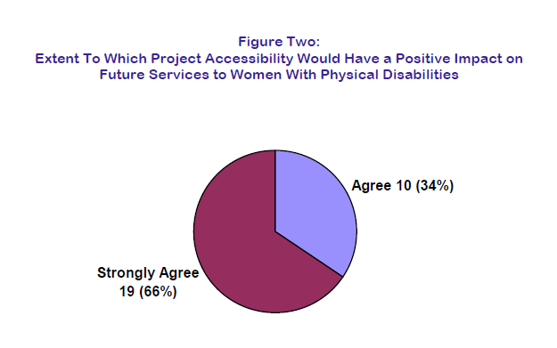
Positive Impact on Future Services to Women with Physical Disabilities

Slide 18
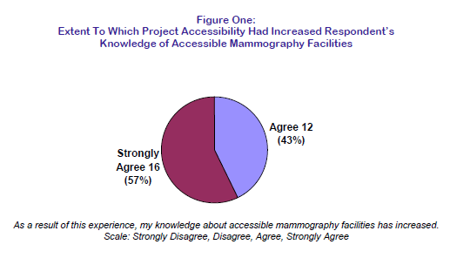
Increased Respondent’s Knowledge of Accessible Mammography Sites

Slide 19
Facility Staff Needs-Top 8 Needs
Locate sign language interpreters
How to help women with disabilities realize the importance of maintaining their breast health
How to better serve women with physical disabilities
How to better serve women with sensory disabilities

Slide 20
Facility Staff Needs-Top 8 Needs
Materials in alternative formats
Sensitivity training for staff, including information on disability etiquette
Information about Patient navigator programs
Information on other funded projects that serve women with disabilities

Slide 21
Next Steps
Project Accessibility-Replicate nationwide
Bridging the Gap: No Woman Left Behind
Susan G. Komen Funded Project 2011-2012
Educate:
  Women with Disabilities in Komen Service Areas
  Community Organizations, Faith Based Organizations, Disability Groups
  Health Care Providers

Slide 22
Contact Information
Roberta Carlin
rcarlin@aahd.us
Janet Kreitman
  jkreitman@aahd.us
  American Association on Health and Disability
  (301) 545-6140

